Slide 1
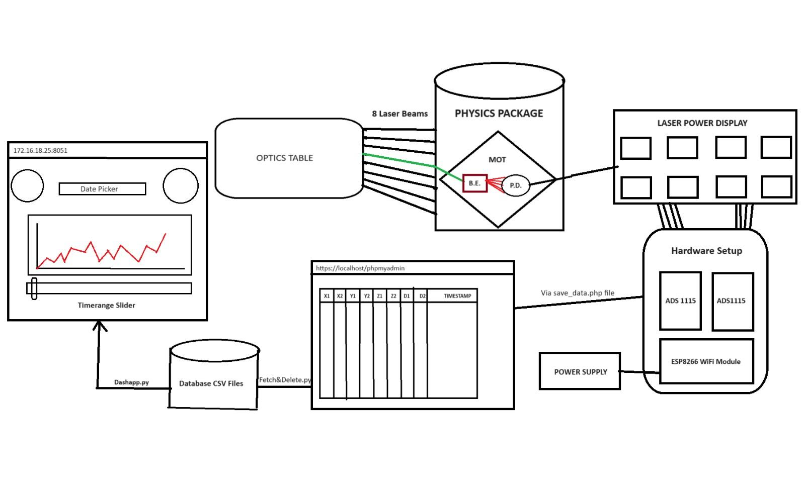

Remote Monitoring Interface For Critical Parameters In Atomic Clock
by Moksh Yadav

Slide 2

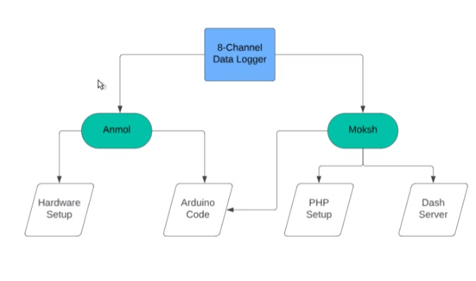
Project Overview
1
Integrated Approach
We have used Arduino IDE, VS Code as well as PHP server to implement our codes.
2
Collaboration
The project was developed by a team of two members, Me and Anmol with each member contributing their expertise.
3
Flexibility
All the codes are flexible to be updated and store even if more channels are used at NPL and needs to be measured and displayed.

Slide 3




Data Flow Funnel
Arduino Code
1
C++ Arduino code is kept in hardware and it functions to find maximum values and serve it on PHP.
Php Server
2
Data comes to sensor_data in form of table with timestamping of values.
SQL Connector Python
3
This code takes data from the PHP server and saves each entry with a unique id for each entry for day and a new csv file for the day.
4
Dash Server
Server fetches from csv files having live_data_ in front and takes their values to present as output.

Slide 4
MOTIVATION

Slide 5
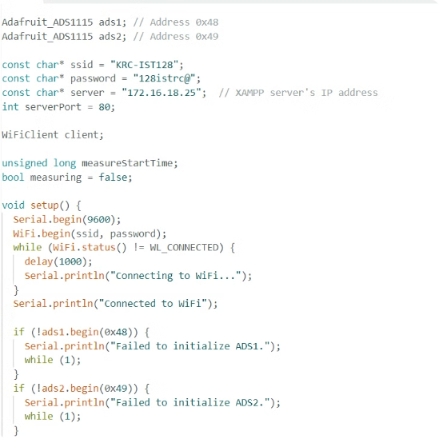
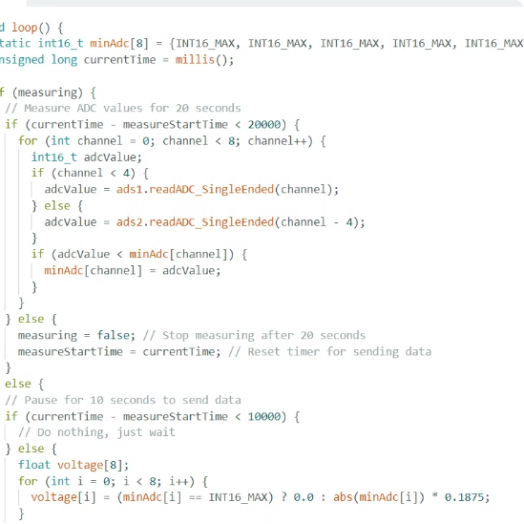
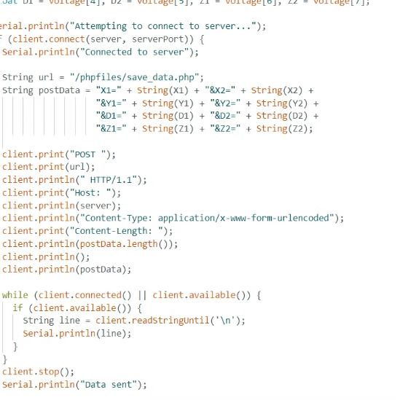
Arduino Code
Initialization
For Loop
Server Connectivity
We have initialized both adcs as adc1 and adc2 as well as given all adcs values as INT_MAX in array as starting of loop.
We have introduced a loop to continuously measure current values and store the maximum values over 20 seconds.
PHP server connectivity code for taking the save_data file and save the code over the PHP server in next 10 seconds for interval to be 30 seconds.

Slide 6

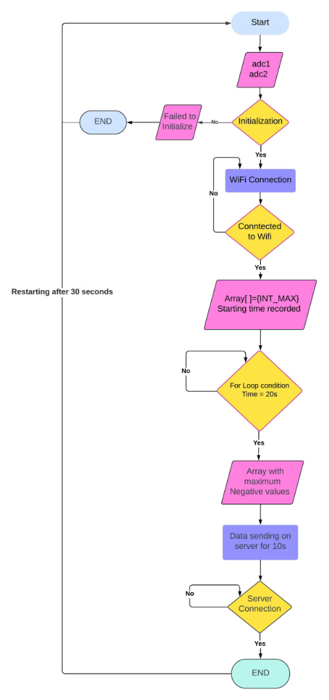
FLOWCHART FOR ARDUINO CODE

Slide 7
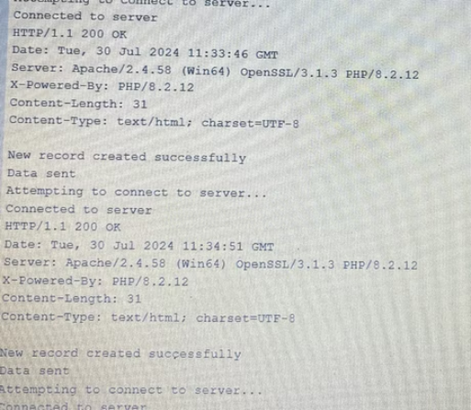
OUTPUT

Slide 8
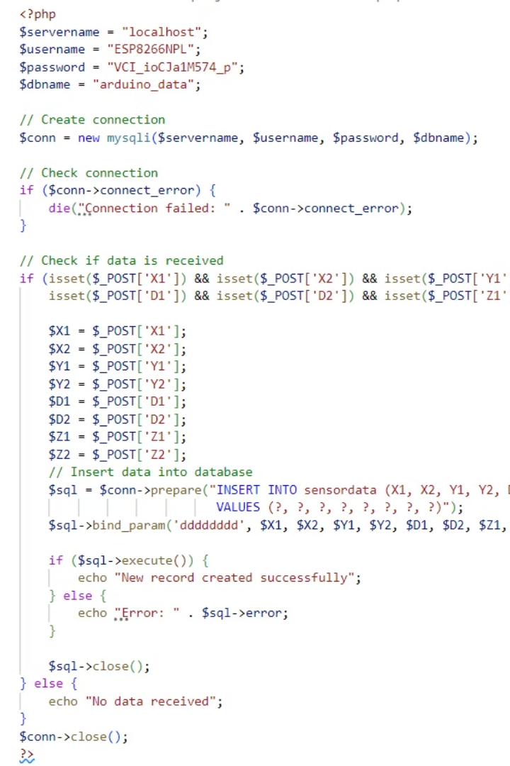
PHP
Initialization
1
Database Username Servername is initialized to justify from where the data is to be saved.
Data Recieved or not
2
Code checks for data if data is incoming or not otherwise prints data not recieved as written in else loop.
Insert Data
Uses sql commands to push the current data into the sensor_data table in php server.
3

Slide 9
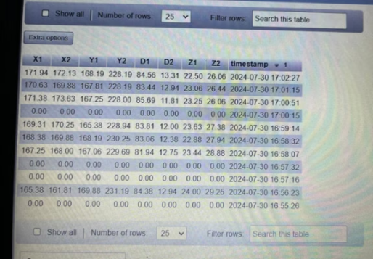
OUTPUT

Slide 10




Python Codes
CSV Fetch & Delete Code
Appending entries from php server to csv files.
Dash Server Code
For better Data visualisation and analysis.

Slide 11
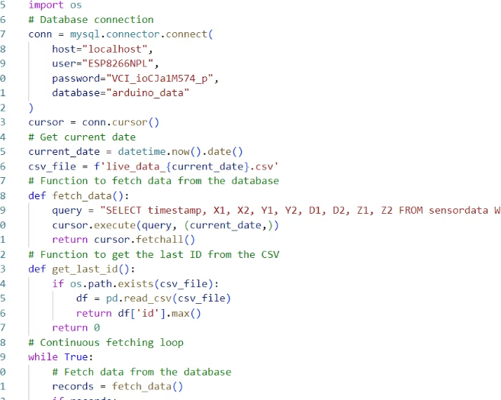
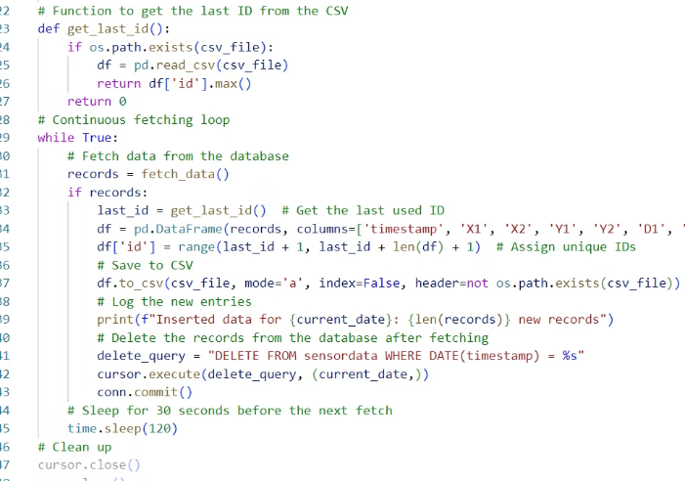
CSV Fetch & Delete Code
Fetching Exact Entry From Database
Giving Each Entry Unique ID
We fetch entry from database selecting all column from sensor data Where timestamp is unique ( sql command )
While storing the entry to csv file we give a unique ID to each entry so that it becomes primary key if we want to analyse it further easily in future.

Slide 12
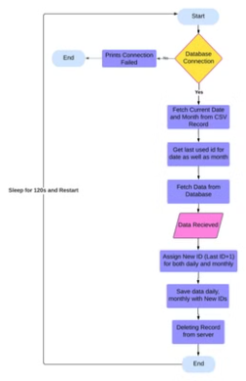
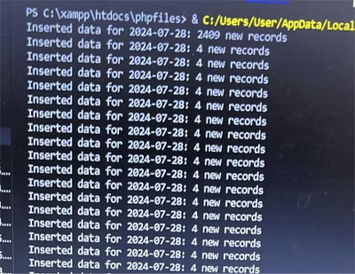
OUTPUT & Algorithm

Slide 13
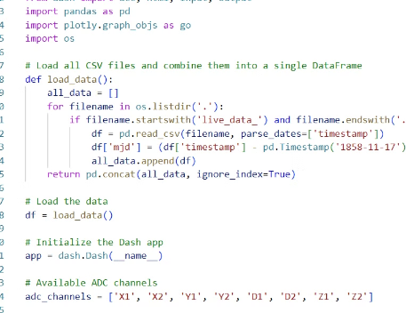
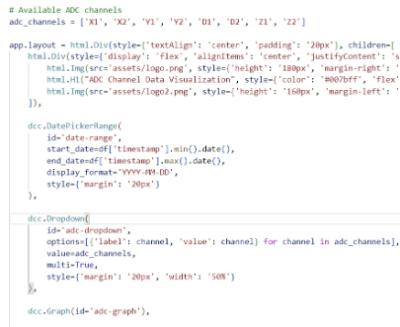
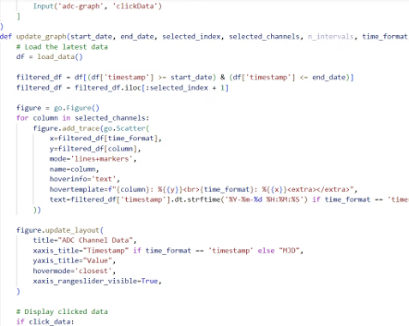
Dash Server Code
App Layout and Components
Data Loading and Preparation
Graph Update and Interaction
The load_data function reads all CSV files starting with 'live_data_' from the current directory, combines them into a single DataFrame, and computes Modified Julian Date (MJD) for each timestamp.
The Dash app layout includes interactive components such as a date picker, dropdown for ADC channels, a slider for selecting data points, and a radio button for choosing the time format (timestamp or MJD). It also features an update interval for refreshing the data.
The update_graph callback function filters data based on user inputs, generates an interactive Plotly graph for selected ADC channels, and updates with real-time data. It also displays information about clicked data points on the graph.

Slide 14
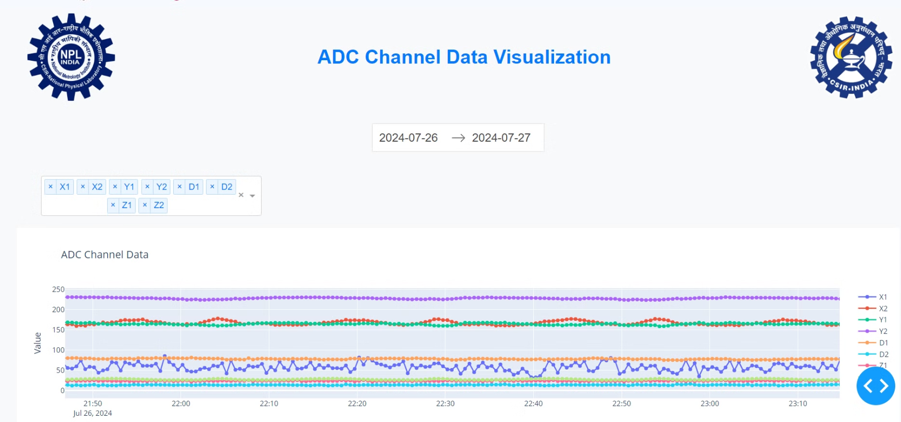
OUTPUT

Slide 15
HARDWARE COMPONENTS
ADC1115
ESP8266
1
High Resolution
1
Connectivity
Offers 16-bit resolution for precise data capture.
The ESP8266 features built-in Wi-Fi for IoT applications.
2
Multiple Channels
2
Low Cost
Up to 4 analog input channels allow for multi-sensor integration.
The ESP8266 is an affordable microcontroller option.
3
Versatility
3
Accuracy
The ESP8266 can be used in a wide range of projects.
Reliable and consistent analog-to-digital conversion.
4
Power Efficient
4
Compatibility
The ESP8266 operates on low power, making it ideal for battery-powered devices.
Integrates seamlessly with a variety of microcontrollers.

Slide 16
Thank You !

